Slide 1
STICAT
Bilingual version
Project Report
By：Rose Aria Audrey Maggie

Slide 2
01
Overview & Plan & Progress
Achievements Display
02
contents
03
Challenges & Solutions & Problems
Rewards & Harvest
04

Slide 3
01
Overview
Plan
Progress

Slide 4

L
About STICAT
STICAT is a Computer Aided Tool developed by Rose and some other students in teacher Han's class when we learn database principles.
URL: http://sti.blcu.edu.cn/sticat
STICAT Logo

Slide 5
Techniques in STICAT
This tool mainly uses HTML, CSS, JavaScript, Ajax, Bootstrap, PHP.
In order to realize reading files function and align function at the same time, we use API to import the files.
In order to get Machine Translation as reference, we use Baidu Translation API.
In order to get matched Translation Memory, we calculate the Levenstein edit distance and take sentences that match up to 60%.
As for the whole management system, we also designed many tables and charts.
All in all, this website concludes many pages. So it is quite suitable for our localization practice.

Slide 6
Analysis of the project
Time
Because some fatal mistakes occurred in our previous project BBS. So we have to change our project to STICAT. When we decided to localize, there was only about 4 weeks left.
Personal preference
Maggie and Aria want to try technical works. Audrey would like to do translation job. Rose are prefer to be a Project Manager..
Workload
After preliminary analysis, the site has 86 pages that need to be localized.
Please see Annex 1 for details

Slide 7
Division of labor Please see Annex 2 for details
Rose – Project Manager
Analysis Project, make division and planning, monitor the project, make online tests, make midterm and final report
Maggie – Localization Engineer
Mainly responsible for extracting the texts, Replace the texts into variables.
Aria – Localization Engineer Make switch function, replace the texts into variables, make language packages..
Audrey – Translation
Help Maggie Extract the texts, Translation, quality assurance and online tests.

Slide 8
Plan
STICAT
Analysis & Preparation
Translation & QA
Testing & Report
Technical

Slide 9
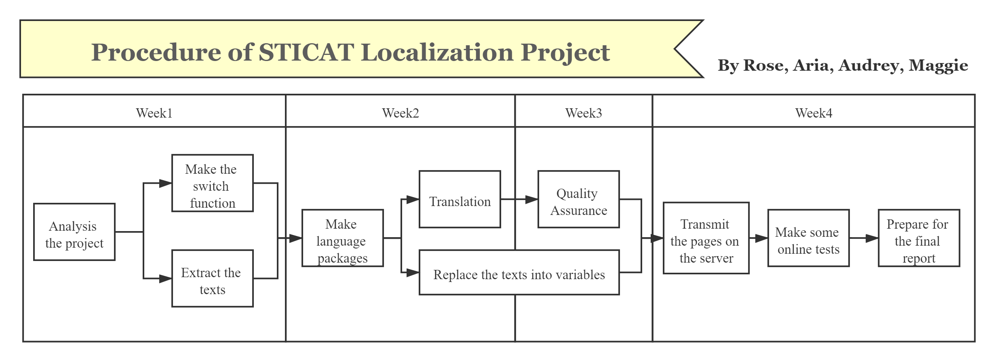
Procedure

Slide 10
02
Achievements Display
URL: http://yangruixia.xyz/sticatbi/login.php

Slide 11
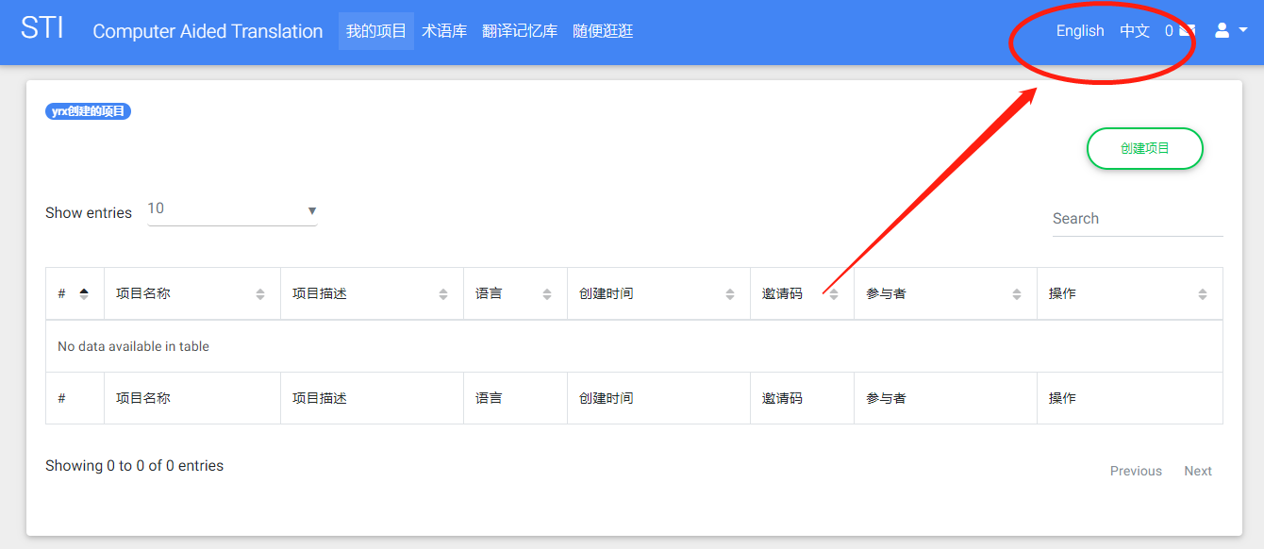
Switch function

Slide 12
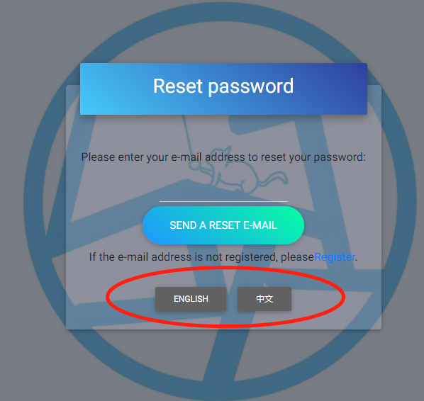
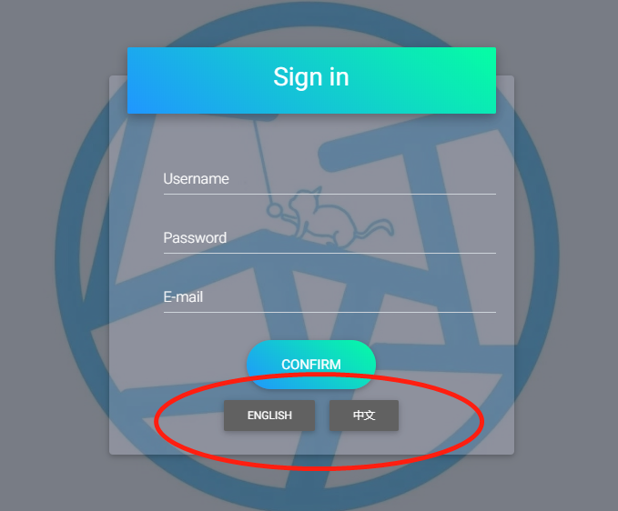
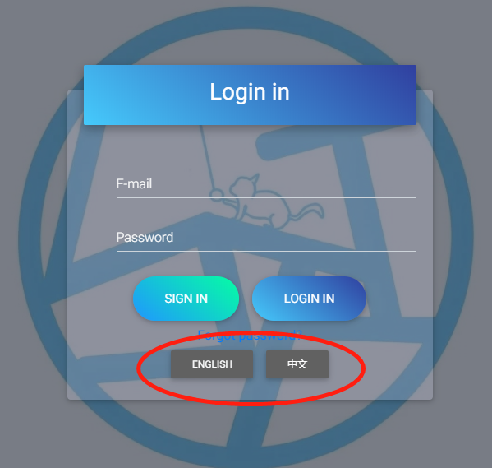
Switch function

Slide 13
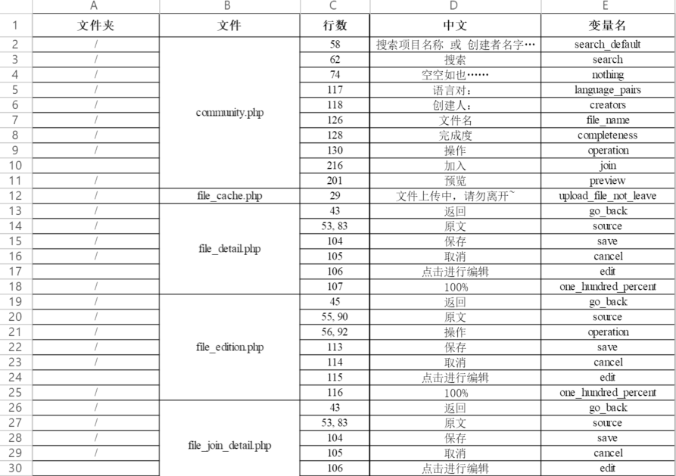
Extracted Texts
We use variables to replace texts.
In order to ensure the consistency of the variable names of the text with the same content, we first extracted the text that needs to be replaced in each file, and gave the text with the same content to the unified variable name when we do translation.
Here is the text extracted from each file that needs to be replaced.
Please see Annex 3 for details

Slide 14
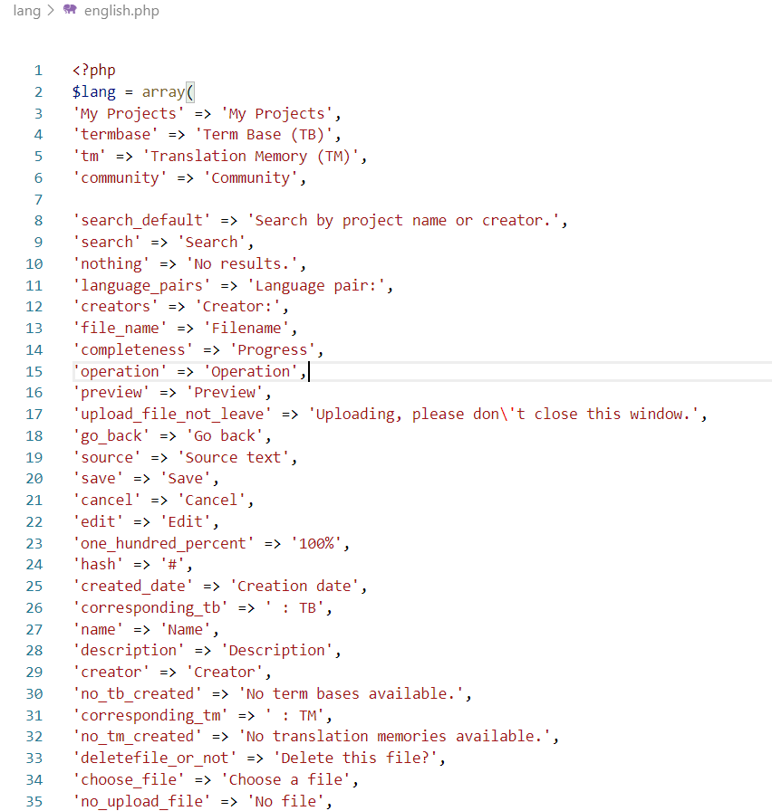
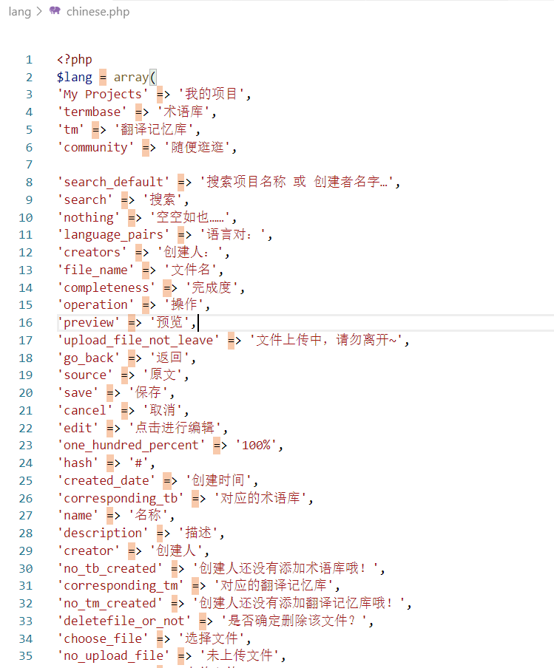
Language Packages
We mainly use language packages to make bilingual function. We have English language package and Chinese language package. Each package has 191 language pairs.

Slide 15
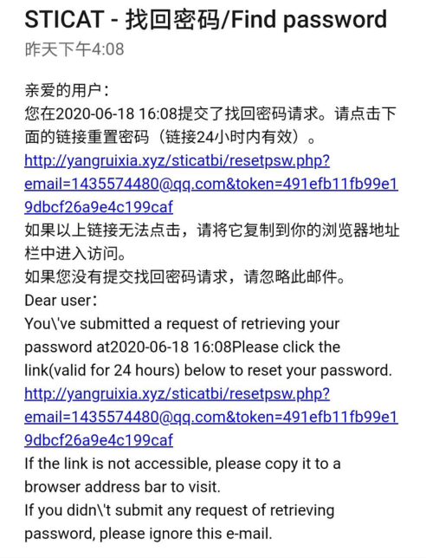
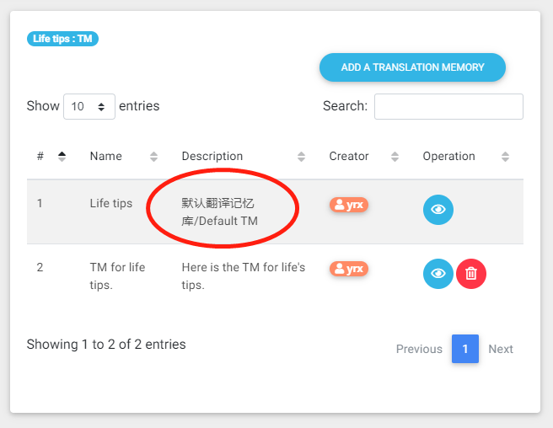
Bilingual texts in codes
For the email content, we use bilingual version in codes directly.
For some default parameters, we use bilingual version and save them in data base directly.

Slide 16
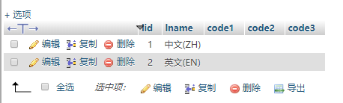
Change of Data Base
We also do some adjustment in our database.
For the lang form, we use EN and ZH to represent English and Chinese.

Slide 17
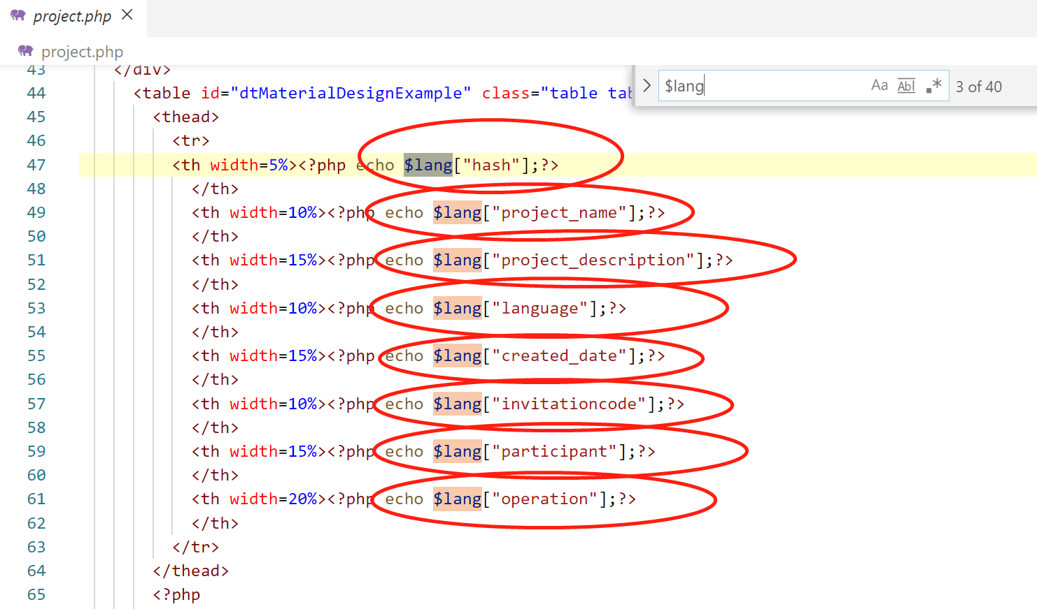
Replaced texts in pages
We have completed the replacement of text in 86 pages.
And there are hundreds of texts to replace.
Localization engineers have to replace these texts one by one.

Slide 18
03
Challenges Solutions Problems
Notes:
PPT模板： www.1ppt.com/moban/ 行业PPT模板：www.1ppt.com/hangye/
节日PPT模板：www.1ppt.com/jieri/ PPT素材： www.1ppt.com/sucai/
PPT背景图片：www.1ppt.com/beijing/ PPT图表： www.1ppt.com/tubiao/
优秀PPT下载：www.1ppt.com/xiazai/ PPT教程： www.1ppt.com/powerpoint/
Word教程： www.1ppt.com/word/ Excel教程： www.1ppt.com/excel/
个人简历： www.1ppt.com/jianli/ PPT课件： www.1ppt.com/kejian/
手抄报： www.1ppt.com/shouchaobao/ 试题下载： www.1ppt.com/shiti/
教案下载： www.1ppt.com/jiaoan/ 字体下载： www.1ppt.com/ziti/

Slide 19
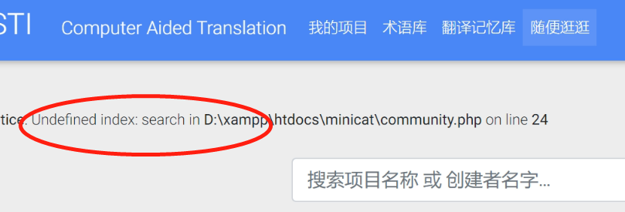
Challenge 1
Aria encountered many problems when making the switch function:
1. Because of the problem of passing parameters, the parameters may be in the URL. If you use the get method to change the page’s language directly, the parameters will be lost.
2. JavaScript cannot be used because JavaScript cannot set session.
Aria

Slide 20
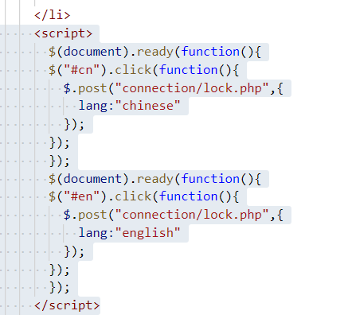
Solution 1
Aria uses Ajax technology to set the language. The code is shown on the right.
Aria

Slide 21
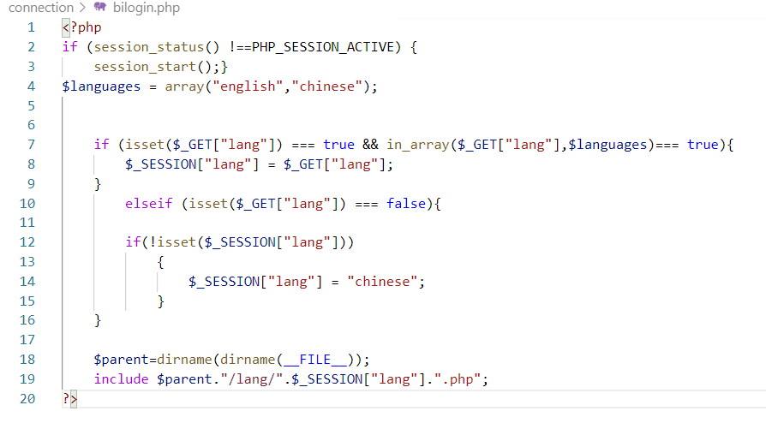
Challenge 2
When coding the bilingual conversion function of the login interface, the post method is not applicable.
Solution 2
Aria use a totally different way (GET) to make the switch function.
Aria

Slide 22
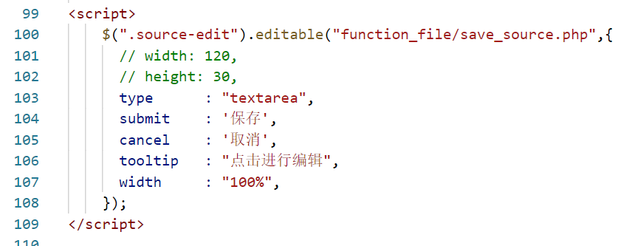
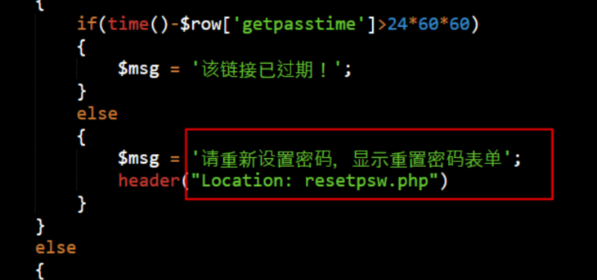
Challenge 3
We also encountered a problem when extracting the content of the page.
Because the person who extracted the content of the page (Maggie & Audrey) are not the developer, they usually confused about some texts’ corresponding pages, such as shown on the right.
This may cause some places to be missed, and some places that do not need to be extracted.
Rose

Slide 23
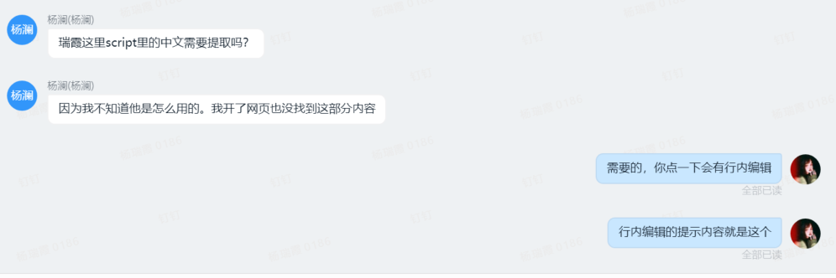
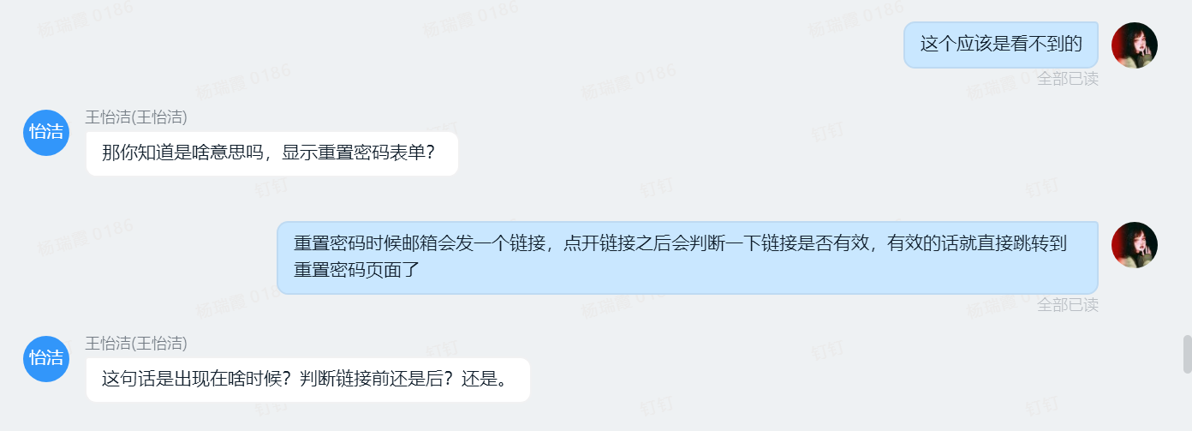
Solution 3
1.View the corresponding original page.
2.Communicate with the developer (Rose) in time, and ask the developer (Rose) at any time if you don’t understand
At the same time, compared to WeChat, we have adopted DingTalk. It is more efficient. As shown on the right are some of our communication records.
Rose

Slide 24
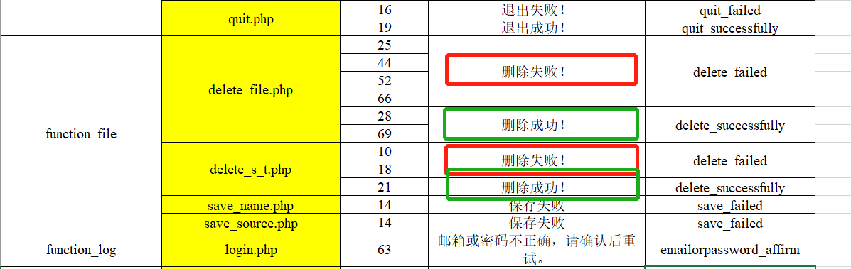
Challenge 4
We extracted all the texts and put them all together in an Excel sheet. Translator Audrey will do the translation according to the sheet.
Audrey found that there are many repeated texts and many sentences with same sentence pattern.
Audrey

Slide 25
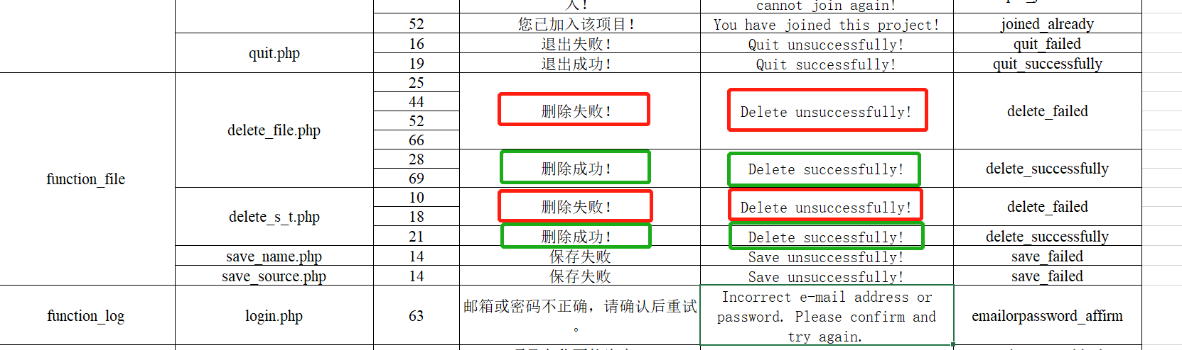
Solution 4
In order to improve translation quality and efficiency, Audrey use memoQ as her CAT.
Translation memory and term base are perfect functions to unify the translation for the texts including many repeated sentences and words.
Audrey

Slide 26
Challenge 5
How to make sure about the quality assurance?
There are many challenges.
Since we are not English speakers, so it’s important to get some suggestions from an English speaker.
Another challenge is the order of words in a sentence. The original string’s position is replaced by the variable name, so the word order cannot be directly replaced
Audrey

Slide 27
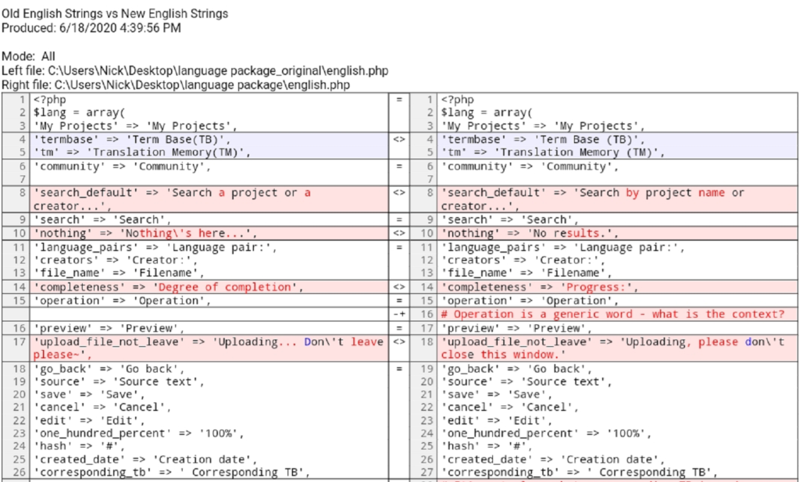
Solution 5
We invited Mr. Lambson to make Quality Assurance. And he gave us many useful suggestions.
Audrey

Slide 28


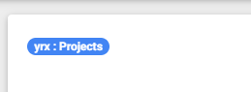

Solution 5
In order to resolve the word order problem, Audrey tries to translate according to the Chinese word order, and replace it with punctuation (such as colons.)
Audrey

Slide 29
Challenge 6
There are 86 pages which need to replace the texts into variables. And it’s quite easy to ignore the texts in codes.
At the same time, there are many different kinds of codes. We must adopt many different ways to replace the texts.
Maggie

Slide 30
Solution 6
In order to make sure we haven’t ignore some texts in codes, we did many online tests to make sure everything goes well.
As for the different kinds of codes, we mainly adopt the following 3 methods:
<?php echo $lang["variable name"];?>；
echo "<script>alert('".$lang["variable name"]."');location.href='../file.php?id=".$pr_id."'</script>"；
die('$lang["variable name"].mysqli_error($conn)')
Maggie

Slide 31
04
Rewards
&
Harvest

Slide 32
Project Manager
Fulfil the wish / Deeper understanding of L10N process / Cooperation
Localization Engineer
Cooperation
Understand how to deal with code error
Rose
Maggie
Localization Engineer
Learn more about L10N, more smooth coding
Translator
Get translation skills / Cooperation
Aria
Audrey

Slide 33
STICAT
THANKS

